Slide 1
A New Thermal Network Model for GaN HEMTs
Wayne Struble
Oct 18th 2016

Slide 2
Talk Outline
What is a thermal network model?
Why is a thermal network model so important for GaN HEMTs?
What thermal network models have been used in the past?
Why is this new thermal network model better?
How is the new thermal network model constructed?
Electrical analog of heat flow equations
Analytic solution of the heat spreader problem
Thermal network model implementation into our design tools
Thermal simulations (using new model in ADS) vs measured results
Simulated junction temperature of 12x173μm GaN on Silicon HEMT vs micro-Raman measurements.
Thermal transient simulation of 8x125μm GaN on Silicon HEMT vs gate resistance thermometry measurements.
Conclusions

Slide 3
Thermal Network Model Basics

Slide 4
What is a Thermal Network Model?
A thermal network model is an electrical equivalent circuit that converts instantaneous dissipated power (heat) in a component (transistor) into an instantaneous temperature. Instantaneous temperature is required as an input for accurate GaN HEMT circuit models.
The thermal network model is an electrical circuit “analog” of the heat flow equations bounded by the physical component’s mechanical construction and thermal properties of the materials used.
Given a thermal heat source (Pdiss), the thermal network response returns voltage (i.e. temperature at the heat source).
Heat Source
Substrate
Die Attach
Package
Baseplate
Temperature
(volts)

Slide 5
What is a Thermal Network Model? (transistor example)
Below is a example of a transistor with a thermal node, and it’s thermal network model connection (simulating junction temperature).
Ids
Thermal
+
Vds
-
Pdiss=Vds*Ids (A)
Thermal
Network
Model
Tj (V)
Electrical
Tbase (V)
Power is current
Temperature is voltage

Slide 6
Why is a thermal network model so important for GaN HEMTs?
The electrical properties of GaN HEMTs are “wicked” temperature dependent !!! (EPI sheet Rho, DC IV’s, Gain, Output Power, etc…)
Mobility & EPI Sheet Rho vs Temperature
GaN HEMT IV Curves vs Temperature
typical
operating
range

Slide 7
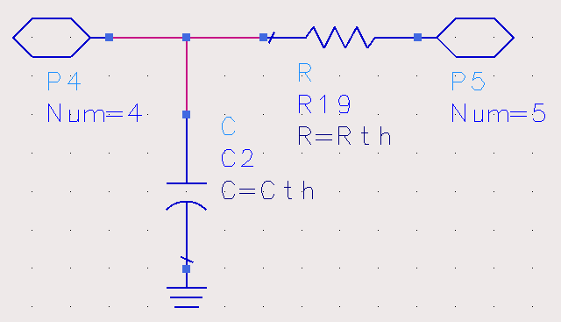
What thermal network models have been used in the past?
Simple single-stage fixed RC network.
Drawbacks of this model are:
No direct physical basis inside the circuit simulator environment.
Single thermal time constant. (continuum in actual physical structures)
Values are calculated from measurements or 3D finite element analysis simulations. (i.e. slow) Not calculated inside the circuit simulator.
Only valid for a fixed geometry, temperature, and dissipated power input.
Any change in above requires new extracted element values.
Pdiss (A)
Tbase (V)

Slide 8
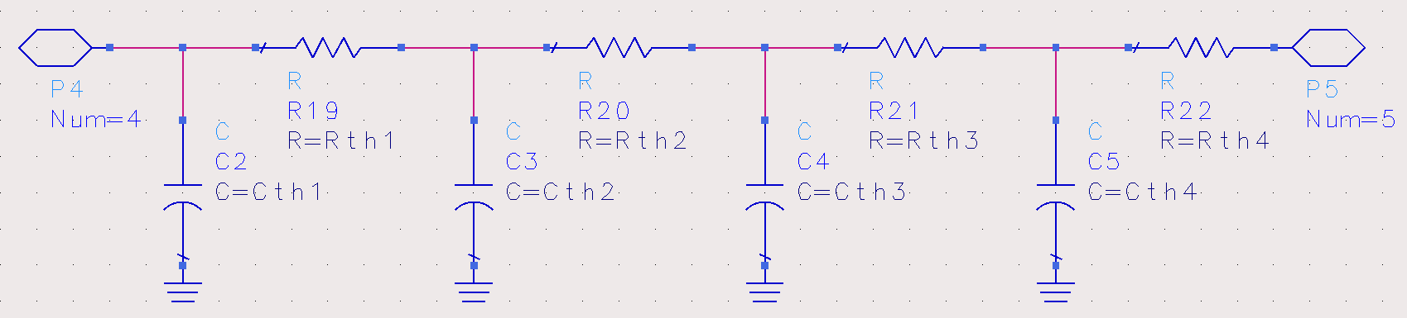
What thermal network models have been used in the past?
Multiple-stage fixed RC ladder network. (continuum of time constants)
Drawbacks of this model are:
Again, no direct physical basis inside the circuit simulator environment.
Values are calculated from measurements or 3D finite element analysis simulations. (i.e. slow) Not calculated inside the circuit simulator.
Only valid for a fixed geometry, temperature, and dissipated power input.
Any change in above requires new extracted element values.
Pdiss (A)
Tbase (V)

Slide 9
Why is the new thermal network model better?
Benefits of the new model are:
Has a direct physical basis inside the circuit simulator environment.
The model is directly calculated using geometry as input, and known material thermal properties over a wide temperature range, so the model very flexible. No model parameter fitting required…
Speed. The thermal network model temperatures are solved simultaneously within the electrical network it is connected to, so it solves at the same speed as your circuit simulation (i.e. fractions of a second, not minutes).
Accuracy. Because it is based on known material thermal properties.
Is valid over a wide range of geometries (substrate thickness, FET fingers, etc.) and temperatures.
Want to use a different gate pitch, die thickness, unit gate width? No problem, simply change the geometry parameters in the model and re-simulate your circuit to see any performance changes.
And it’s really cool !!! ☺ (yes, pun intended!)

Slide 10
Electrical Analog of The Heat Flow Equations
or… How do I solve a physical heat flow problem using a electrical circuit solver?
(i.e. the boring part of the talk!)

Slide 11
Electrical Analog of the Heat Flow Equations (thermal resistance)
Given a volume of material, the direct heat flow equation is:
q = ΔT / R_{th}
where,
q - is the rate of heat conduction (in Watts)
ΔT – is the temperature difference across the surfaces of a volume (in ºC)
R_{th} – is the thermal resistance of the material (in ºC / Watt)
and, R_{th} = L / (K * A)
L – is the thickness of the material (in cm)
K – is the thermal conductivity of the material (in Watts / (cm-ºC) )
A – is the effective area of the material (in cm²)
q
Material Volume
A
T₁
L
T₂
K

Slide 12
Electrical Analog of the Heat Flow Equations (thermal resistance)
The “direct current” electrical-thermal analog is now as follows:
I = V / R <=> q = ΔT / R_{th}
Current (Amps) represents heat conduction (Watts)
Voltage (Volts) represents temperature (ºC)
Resistance (Ohms) represents thermal resistance (ºC/Watt)

Slide 13
Electrical Analog of the Heat Flow Equations (thermal capacitance)
Given a volume of material , the displacement heat flow equation is:
q = C_{th} dT / dt
where,
q - is the rate of heat conduction (in Watts)
dT / dt – is the rate of change in temperature of the volume (in ºC / s)
C_{th} – is the thermal capacitance (heat capacity) of the material (in Joules / ºC)
and, C_{th} = C_{p} * m or C_{th} = C_{p} * L * A * p
C_{p} – is the specific heat capacity of the material (in Joules / (Kg-ºC) )
m – is the mass of the cell volume (in Kg)
L – is the thickness of the cell (in cm)
A – is the effective area of the cell (in cm²)
p – is the density of the material (in Kg / cm³)
q
Material Volume
@ Temperature T
A
L
K

Slide 14
Electrical Analog of the Heat Flow Equations (thermal capacitance)
The “displacement current” electrical-thermal analog is now as follows:
i = C dv / dt <=> q = C_{th} dT / dt
Current (Amps) represents heat conduction (Watts)
Capacitance (Farads) represents heat capacity (Joules / ºC)
Rate of change of Voltage (Volts / s) represents rate of change
of temperature (ºC / s)
Therefore our electrical “analog” components describing heat flow are shown below: Rth & Cth are nonlinear functions of voltage (temperature)
Heat Sources
Fixed Temperatures
Thermal Resistances
Thermal Capacitances
(Watts)
(ºC)
(ºC/Watts)
(Joules/ºC)

Slide 15
Analytic solution of the heat spreader problem

Slide 16
Analytic solution of the heat spreader problem
A well known approximation for solving the heat flow equations (in planar topologies) is to assume that heat flux spreads (from the heat source to the heat sink) at a fixed rate (or angle).
Typically, a 45º spreading angle (or 1:1 spreading factor) is used.
This approximation results in calculated temperatures within 10% of 3D finite element approaches. (for most cases less than a 4% error)
heat
source
θº
sink

Slide 17
Analytic solution of the heat spreader problem (truncated pyramid section)
Below is the analytic solution (for R_{th}) of this heat spreader problem for a given material. (we sum, i.e. integrate, the ΔR_{th} versus depth (z) over the thickness of the section, k is assumed constant)
Where area is a function of depth.
T – thickness of the section
SF – spreading factor (45º=1)
x – x dimension of heat source
y – y dimension of heat source

Slide 18
Analytic solution of the heat spreader problem (truncated pyramid section)
For C_{th} we assume the specific heat capacity is constant throughout the thin section volume. Then we use the standard equation for Cth.
C_{th} = C_{p} * V * p
C_{p} – is the specific heat capacity of the material (in Joules / (Kg-ºC) )
V – is the volume of the section (in cm³⁾
p – is the density of the material (in Kg / cm³)

Slide 19
Analytic solution of the heat spreader problem
I now use these analytic solutions for the new thermal network model.
Unfortunately, the material thermal properties are non-linear functions of temperature (i.e. thermal conductivities & specific heat capacities).
Therefore, we have to divide the geometry into thin vertical sections where material thermal properties are assumed constant.
So, the new thermal network model is composed of a cascaded ladder network of RC sections.
Gates
GaN + AlGaN
Si
Iso-therms
Backside of Die

Slide 20
Analytic solution of the heat spreader problem
Within each section, we calculate the analytic solution for Rth and Cth using the heat spreader approach.
For GaN on Silicon HEMT’s, the semiconductor is separated vertically into three distinct regions.
AlGaN+GaN EPI layers (AlGaN+GaN material properties)
The Silicon substrate under each gate finger before the heat fluxes merge
The Silicon substrate after the heat fluxes merge (Silicon material properties)
Gates
GaN + AlGaN
Si
Iso-therms
Backside of Die
Notes:
Spreading factor is a fitting parameter based on measured or simulated thermal behavior

Slide 21
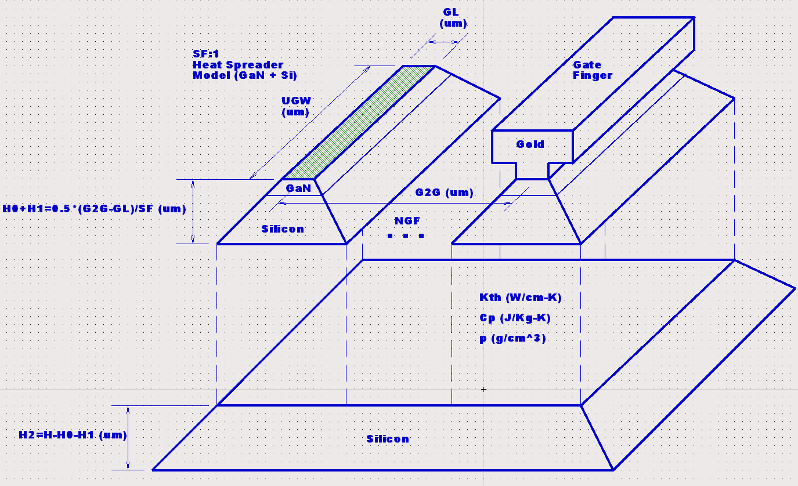
Thermal network model implementation (multi-finger HEMT concept)
multi-finger heat spreader model
Below I show the
Model Parameters:
GL,UGW, NGF, G2G,
H, SF
All Physical !!!

Slide 22
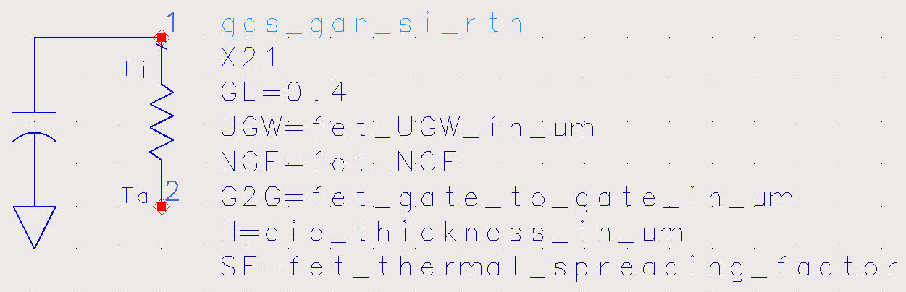
Thermal network model implementation into our design tools
Below is the new thermal network model implemented in ADS (we also have this available in AWR)
ADS Model
length of channel heat source
0.4μm for our GaN on Si
technology

Slide 23
Junction temperature simulation of 12x173μm GaN on Silicon HEMT versus micro-Raman measurements example

Slide 24
12x173μm GaN on Silicon HEMT Thermal Simulation
In the following example, I use the new thermal network model to simulate the junction temperature versus dissipated power of a 12x173μm GaN on Silicon HEMT.
The HEMT die is 50μm thick and mounted in a AC360 package using AuSn eutectic die attach (I assumed 12.5μm bond line thickness).
The baseplate temperatures were 25ºC and 80ºC and dissipated powers simulated/measured were 2-4 Watts/mm (Vds=50v).
Simulated junction temperatures using the new thermal network model are within 4ºC of measured μRaman measurements taken at the University of Bristol.

Slide 25
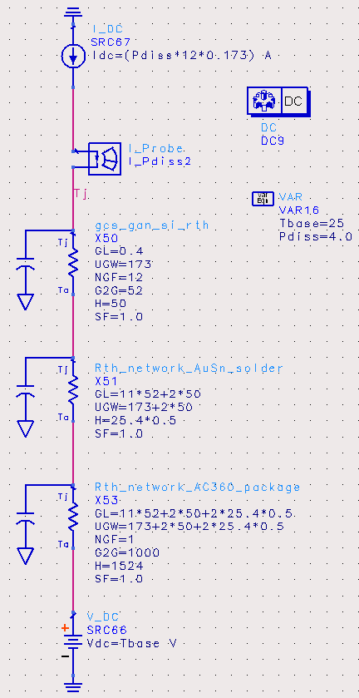
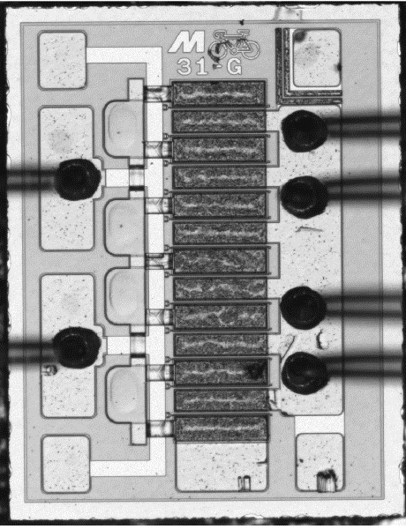
12x173μm GaN on Silicon HEMT Thermal Simulation
12x173μm GaN on Si HEMT (50μm thick)
Pdiss 2-4W/mm
Thermal Model
T_{j}
52μm G2G pitch
50μm
HEMT
die
solder
12.5μm
AC360 package
1524μm
25,80ºC

Slide 26
12x173μm GaN on Silicon HEMT Thermal Simulation (25ºC Baseplate)
New Model Simulation
μRaman Measurements
Micro Raman Measurements
from University of Bristol

Slide 27
12x173μm GaN on Silicon HEMT Thermal Simulation (80ºC Baseplate)
New Model Simulation
μRaman Measurements
Micro Raman Measurements
from University of Bristol

Slide 28
Thermal transient simulation of 8x125μm GaN on Silicon HEMT vs gate resistance thermometry measurements example (under pulsed conditions)

Slide 29
Transient Gate Resistance Thermometry 8x125µm GaN on Si HEMT (T_{a}=85°C)
The following example demonstrates the new thermal network model under dynamic thermal conditions.

Slide 30
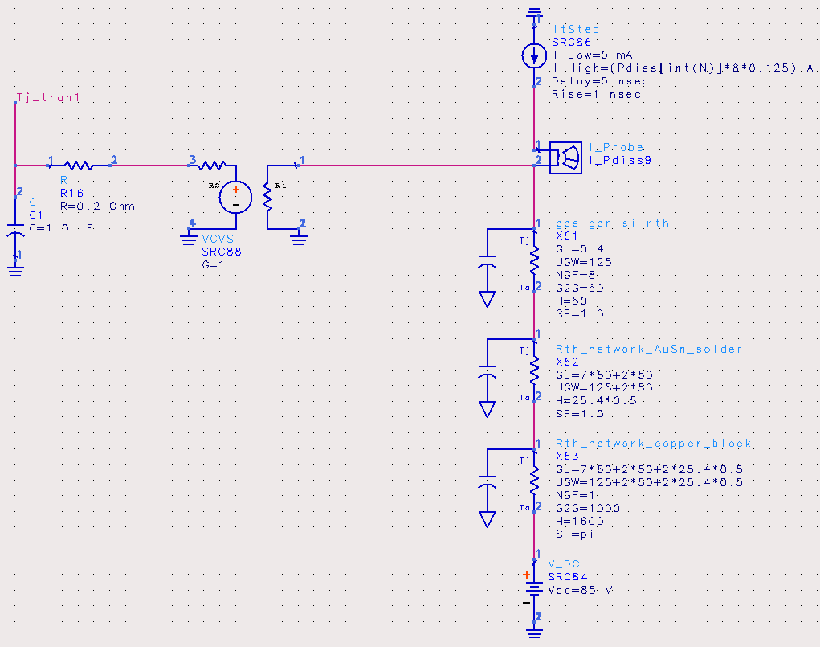
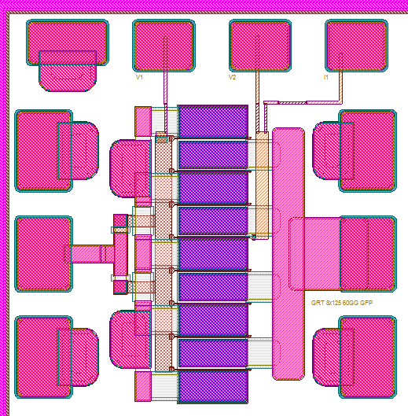
Transient Gate Resistance Thermometry 8x125µm GaN on Si HEMT (T_{a}=85°C)
GRT measurement
response time
Pdiss (pulsed)
T_{j_GRT}
0.2μS
T_{j}
8x125μm GaN on Si HEMT
(50μm thick die 60μm G2G)
50μm
HEMT
GaN on Si die
solder
12.5μm
copper block
85ºC
1600μm
85ºC
GaN on Si Thermal Model

Slide 31
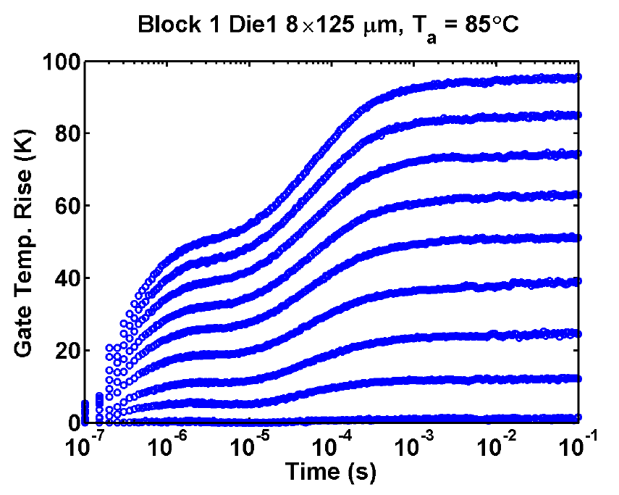
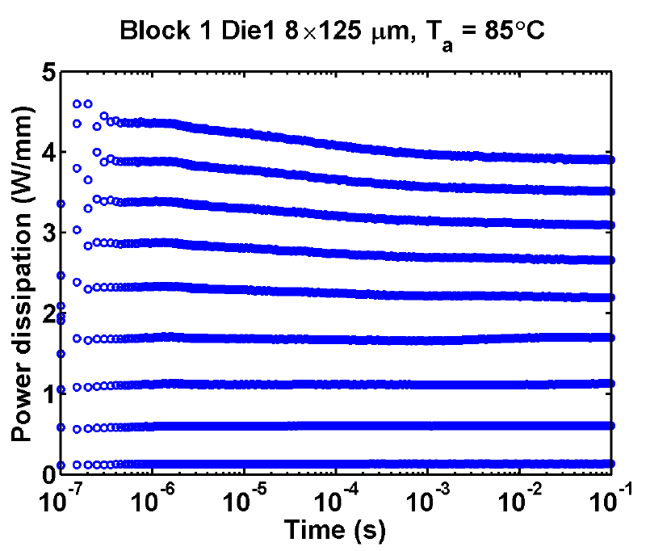
Transient Gate Resistance Thermometry 8x125µm GaN on Si HEMT (T_{a}=85°C)
GRT Measured Data
GaN on Si Thermal Model
Gate temperature vs. time and corresponding channel power dissipations
Measured Pdiss
Model Pdiss Input

Slide 32
Summary
I presented a new thermal network model for GaN HEMTs (that is equally adaptable to any other semiconductor technology).
The model is based on fundamental physical and thermal material properties, easy to use, scalable, accurate, fast, and runs within our standard circuit design tools.
I showed two examples using the model that demonstrate accuracy under both static and dynamic thermal environments.
The model is available in our GaN on Silicon design kits for use with the “Jackal” GaN HEMT model in both AWR & ADS.
Thanks for your attention!
Questions?

Slide 33
Backup Slides

Slide 34
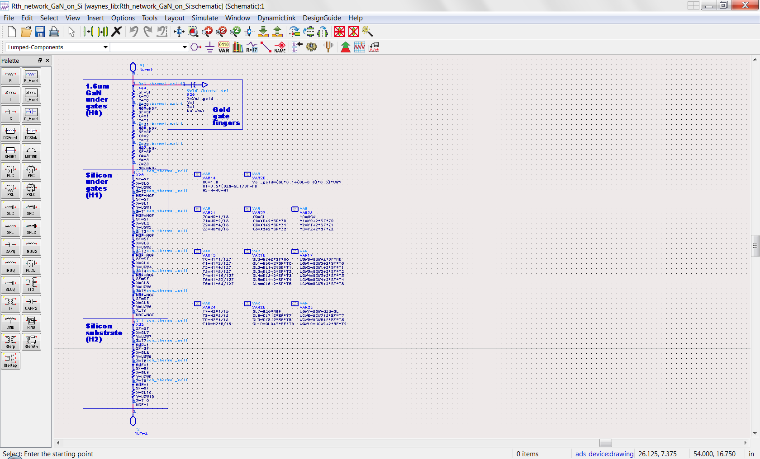
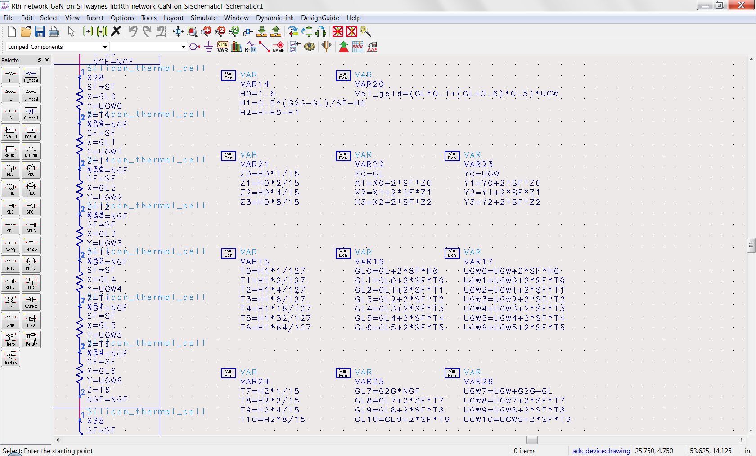
GaN on Silicon Thermal Network Model
ADS “SDD” Model

Slide 35
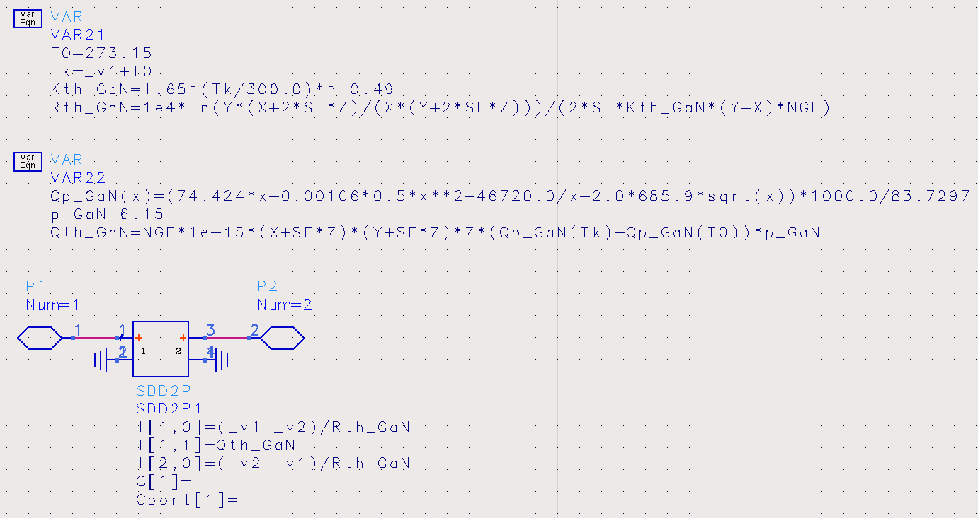
GaN Thermal Cell Model
ADS “SDD” Model

Slide 36
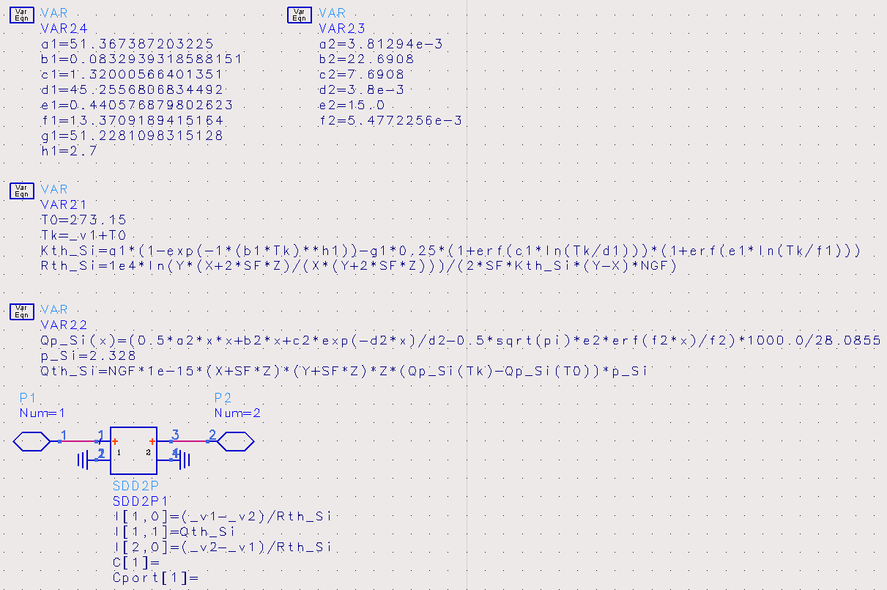
Silicon Thermal Cell Model
ADS “SDD” Model

Slide 37
Silicon Thermal Cell Model (fit versus NIST Data)
Thermal Conductivity of Silicon
Specific Heat Capacity of Silicon

Slide 38
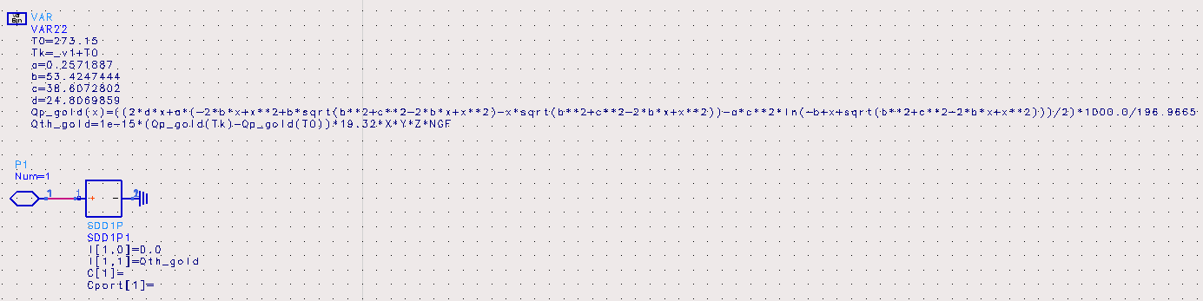
Gold Thermal Cell Model (specific heat capacity only)
ADS “SDD” Model

Slide 39
Gold Thermal Cell Model (fit versus NIST Data)

Slide 40
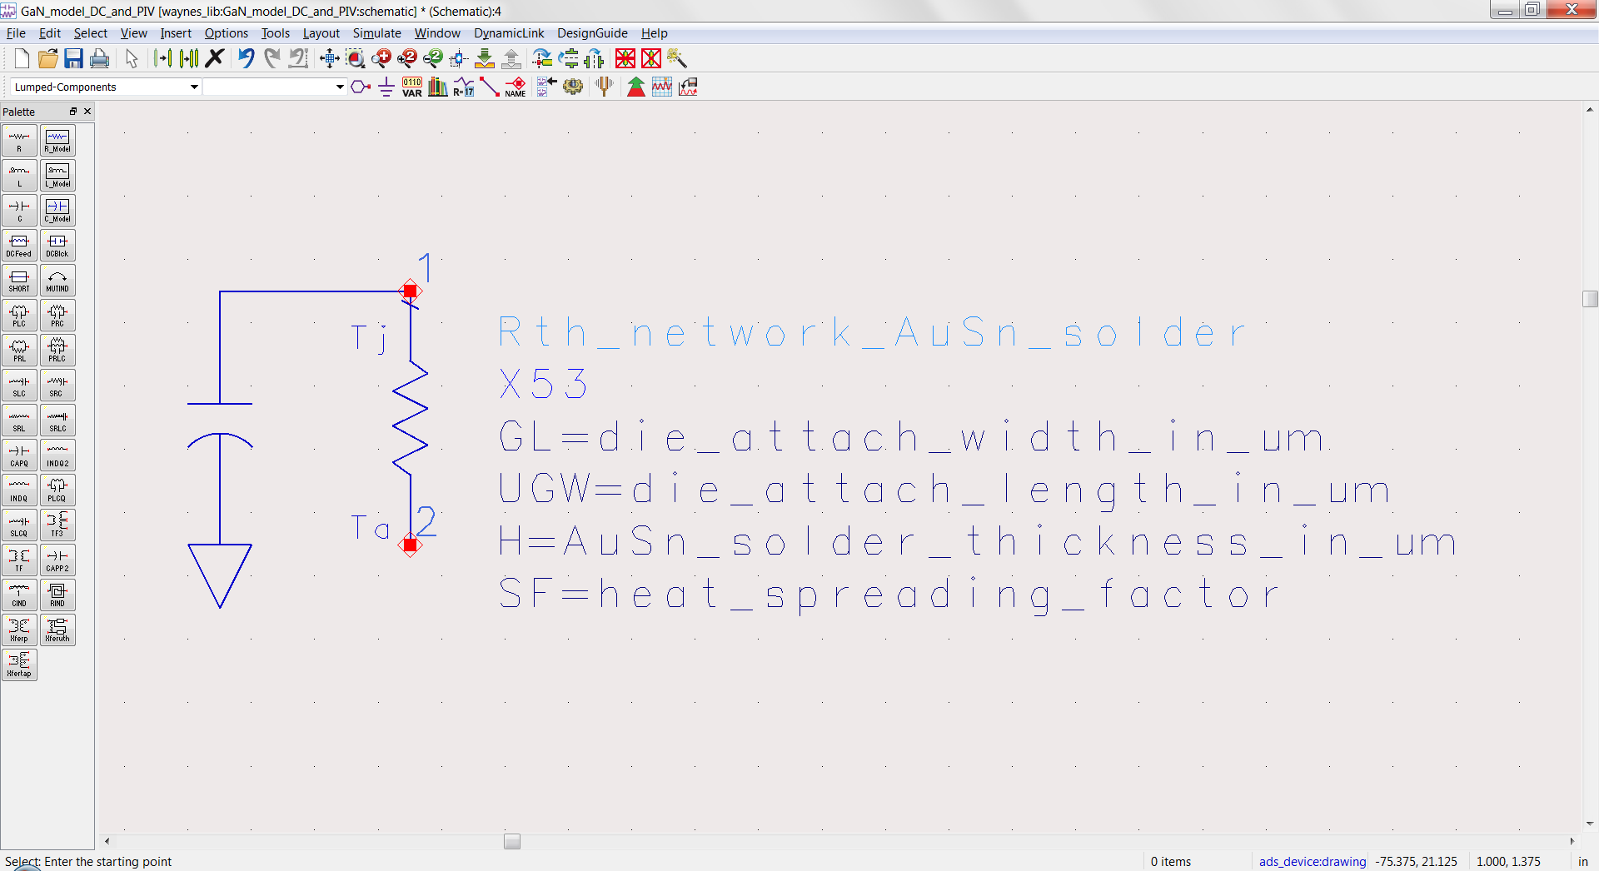
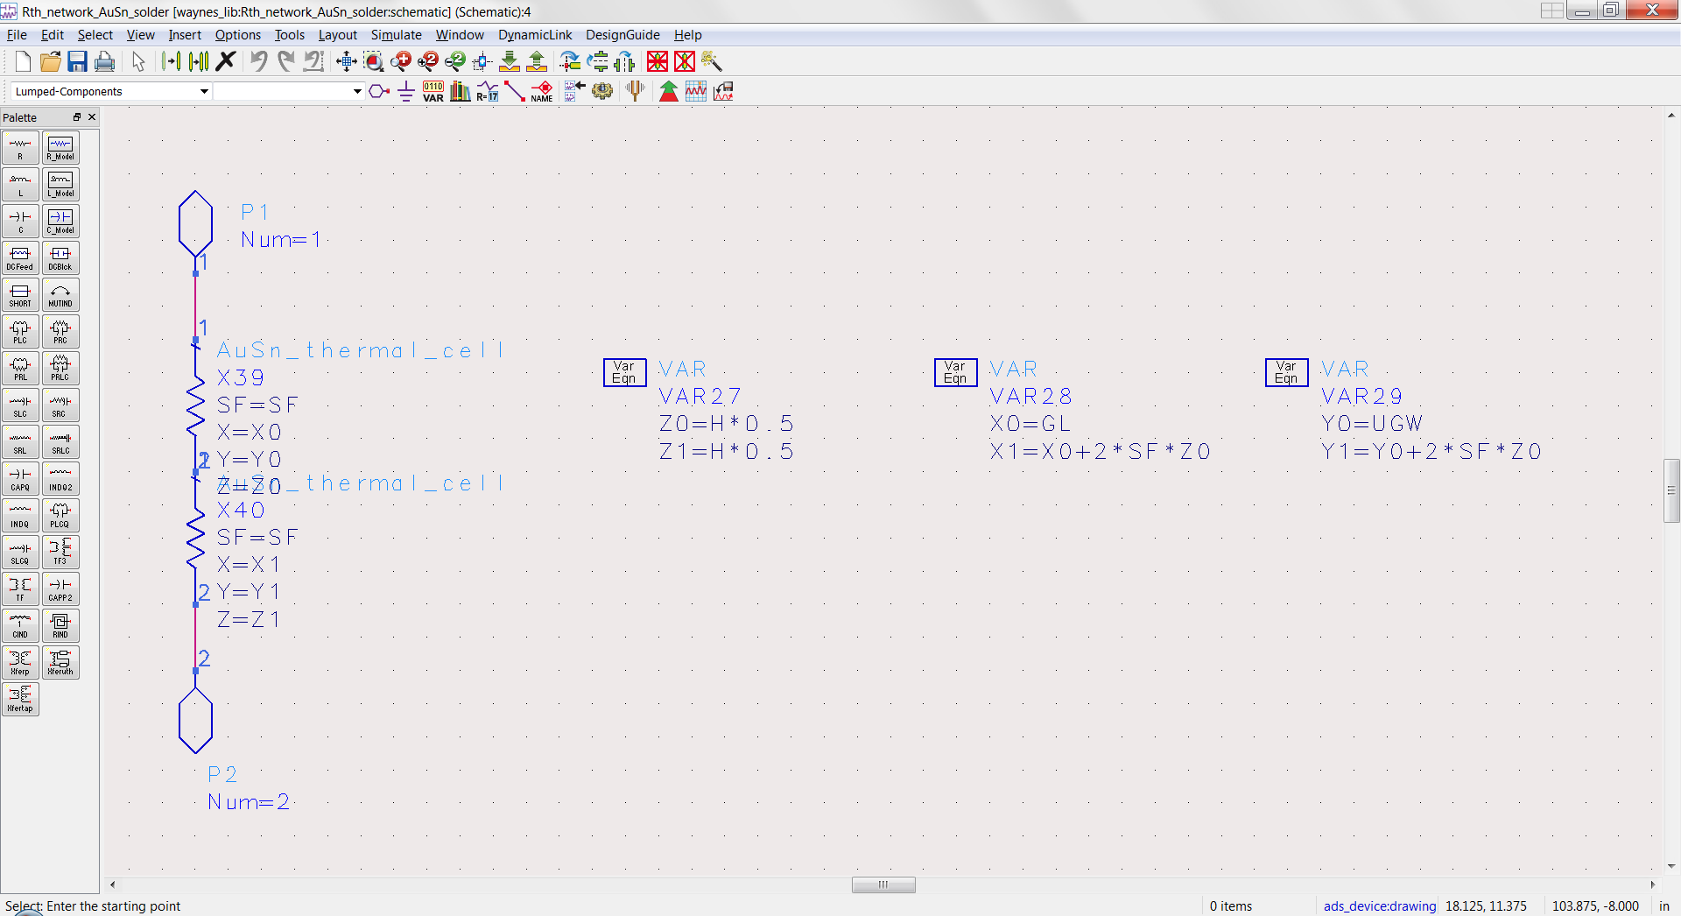
AuSn Solder Thermal Network Model
ADS Model

Slide 41
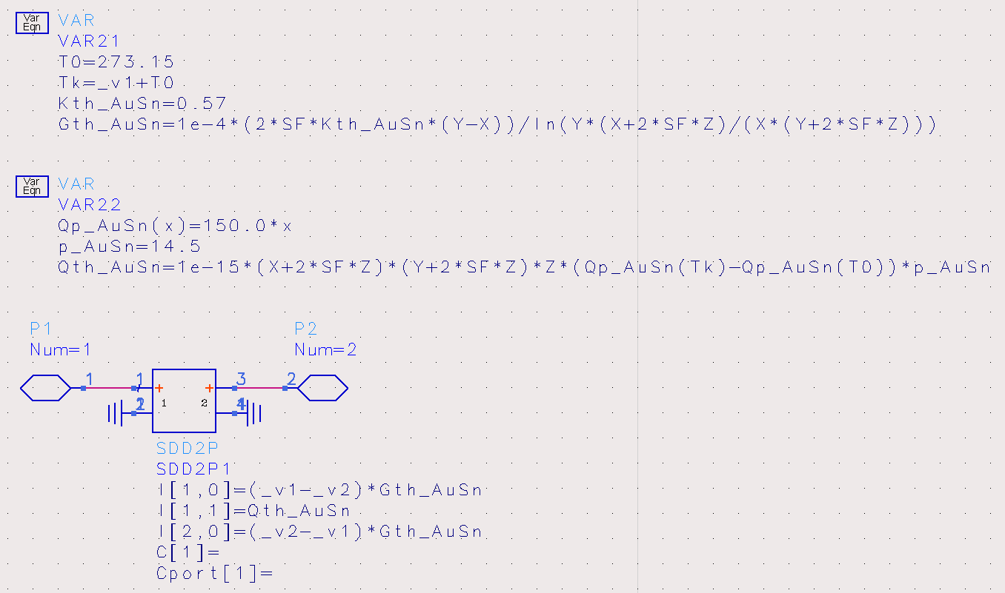
AuSn Solder Thermal Cell Model
ADS “SDD” Model
fixed vs temp Kth = 57 W/m-ºK
fixed vs temp Cth

Slide 42
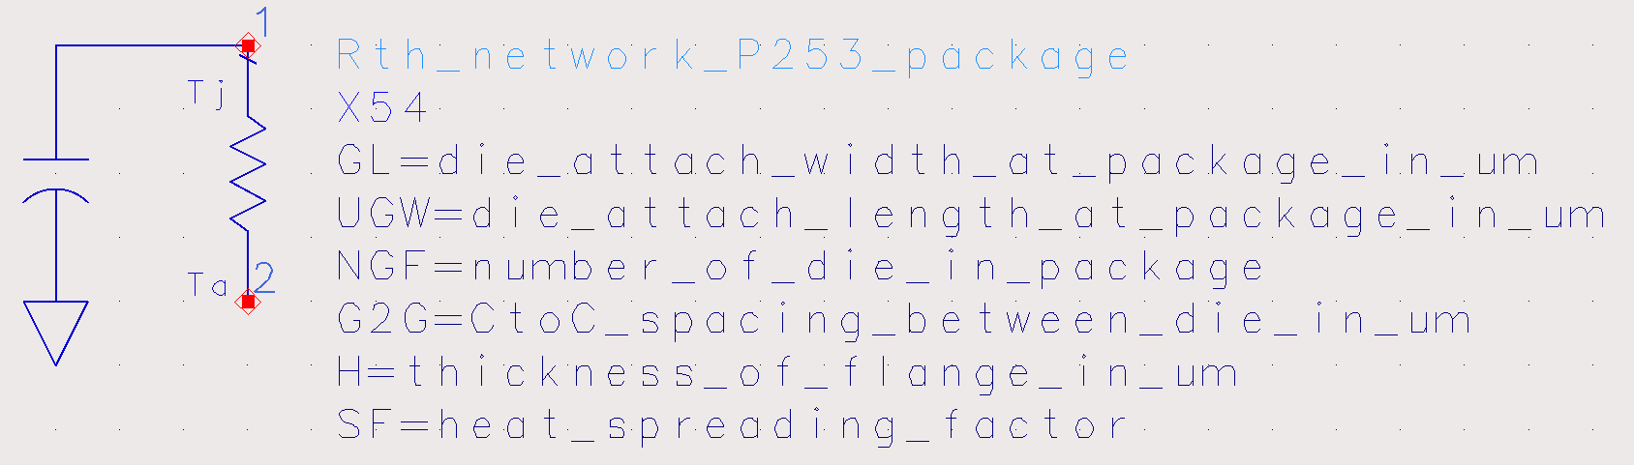
P253 Package Thermal Network Model

Slide 43
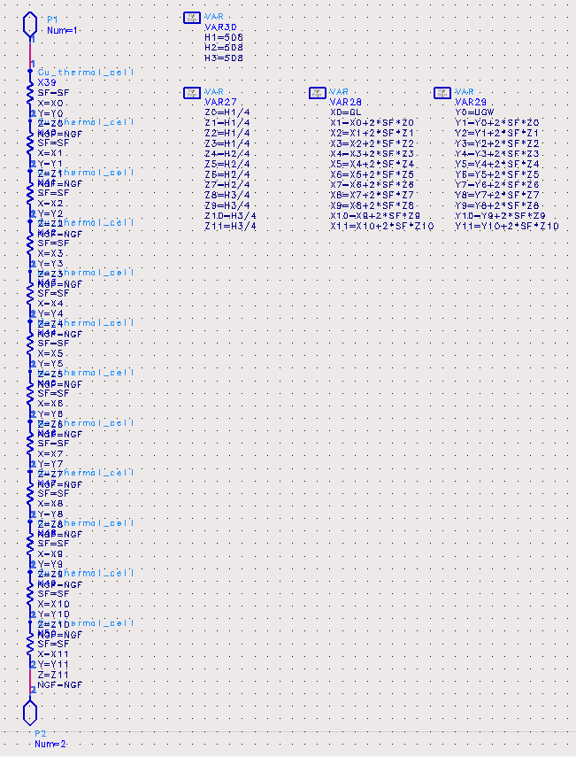
P253 Package Thermal Network Model
ADS Model
Copper
508μm
Moly
508μm
Copper
508μm

Slide 44
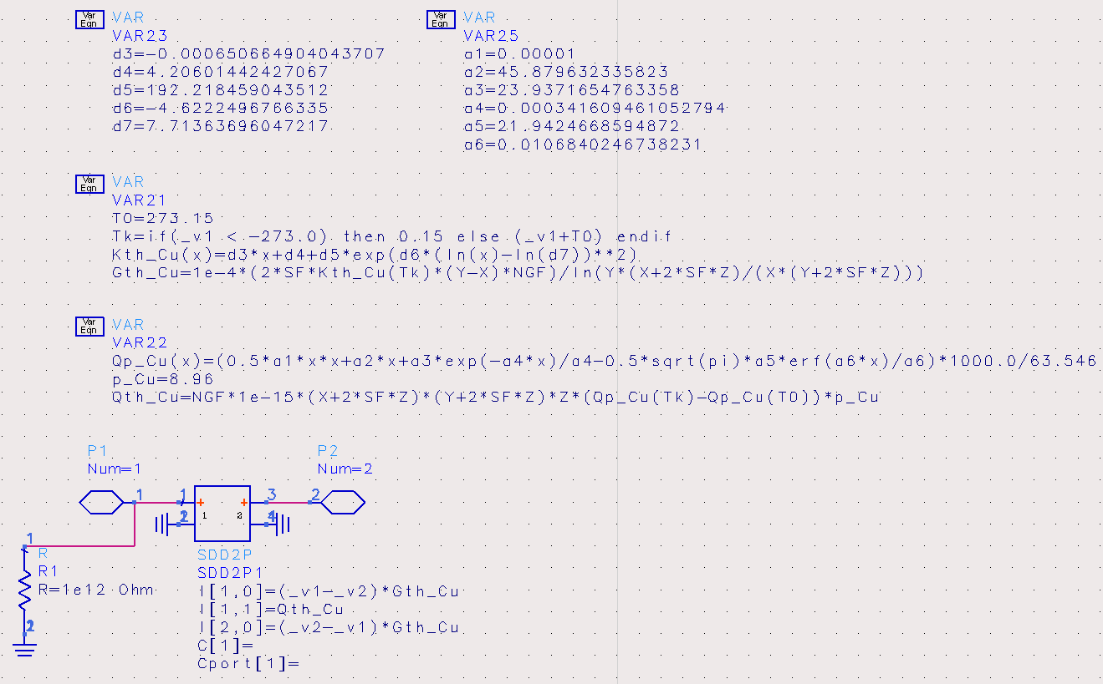
Copper Thermal Cell Model
ADS “SDD” Model

Slide 45
Copper Thermal Cell Model (fit versus NIST Data)
Thermal Conductivity of Copper
Specific Heat Capacity of Copper

Slide 46
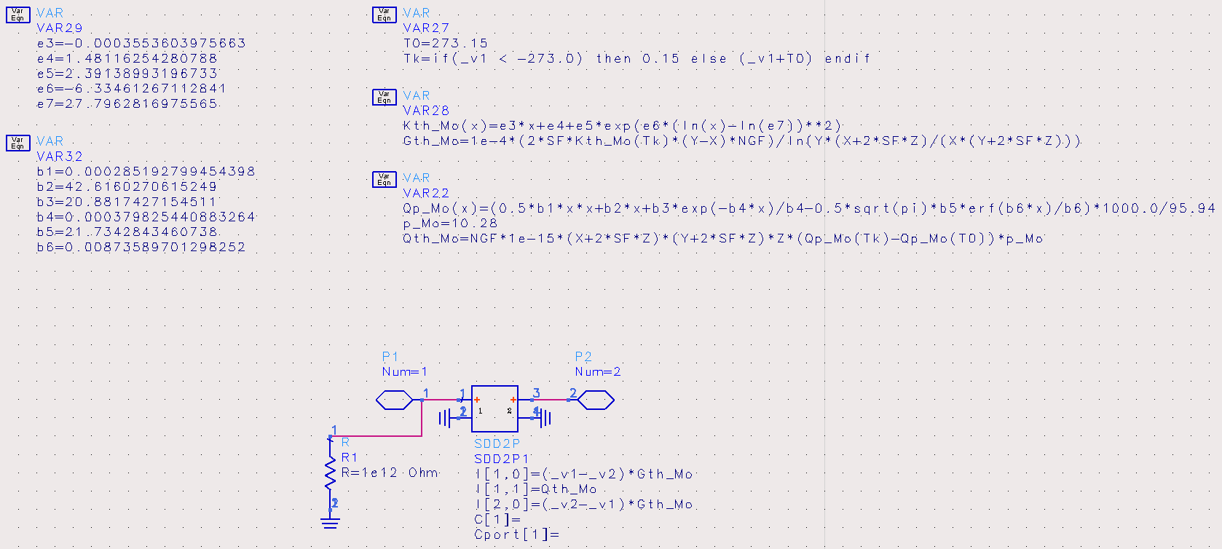
Moly Thermal Cell Model
ADS “SDD” Model

Slide 47
Moly Thermal Cell Model (fit versus NIST Data)
Thermal Conductivity of Moly
Specific Heat Capacity of Moly

